Slide 1


Chemical Synthesis with AI:
Benefits and Drawbacks

Slide 2
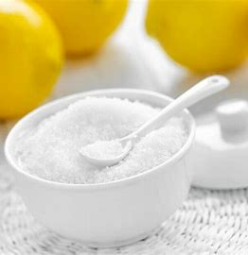

reagent: citric acid
(HO₂CCH₂)₂C(OH)CO₂H
→
HO₂CCH=C(CO₂H)CH₂CO₂H + H₂O
products:
aconitic acid and water

Slide 3
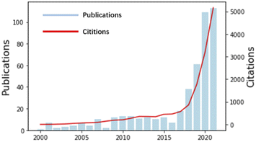
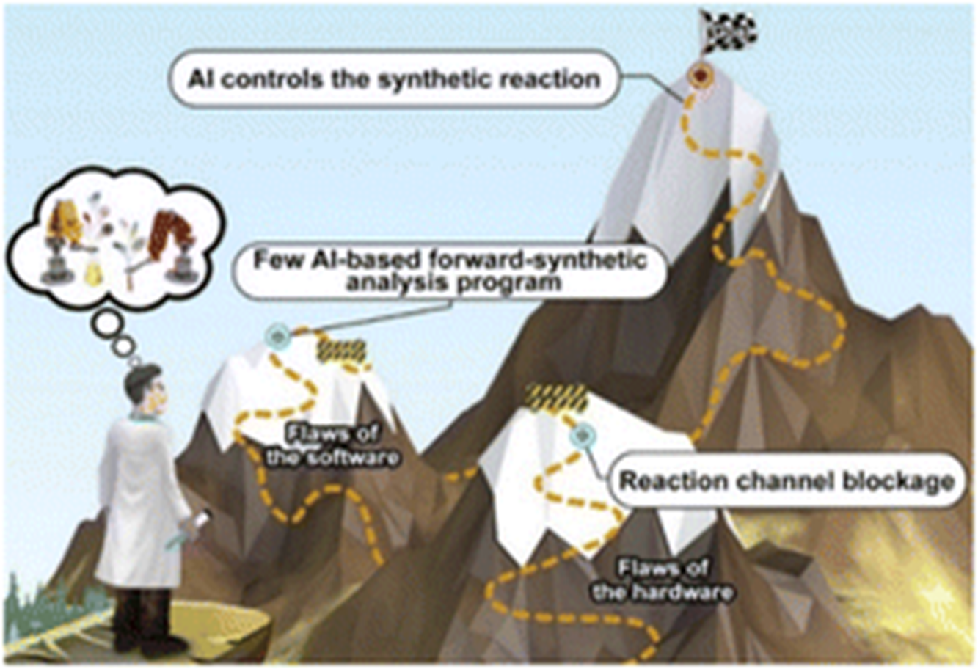
“AI-aided chemical synthesis”
The above line plots show different stories
Drugs
Weapons
Materials

Slide 4

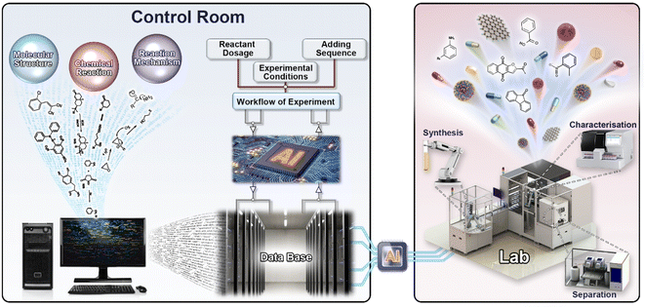

Slide 5
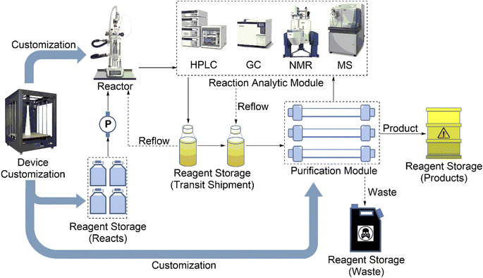

Slide 6
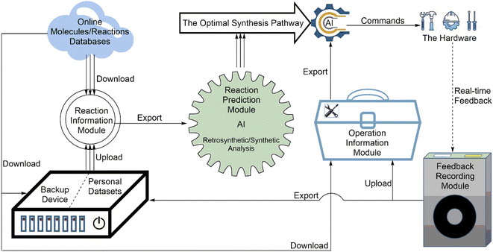

Slide 7
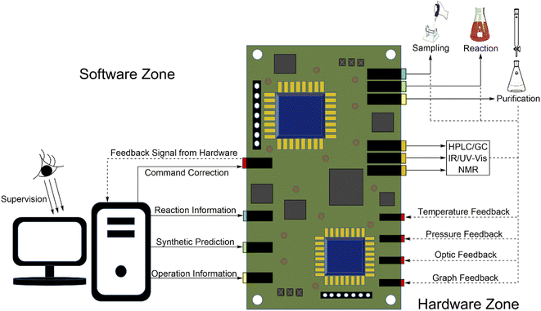

Slide 8

15 drugs ... 96 hours
15 drugs ... 96 hours
15 drugs ... 96 hours
Implications
15 drugs ... 96 hours
15 drugs ... 96 hours
15 drugs ... 96 hours
15 drugs ... 96 hours
15 drugs ... 96 hours

Slide 9
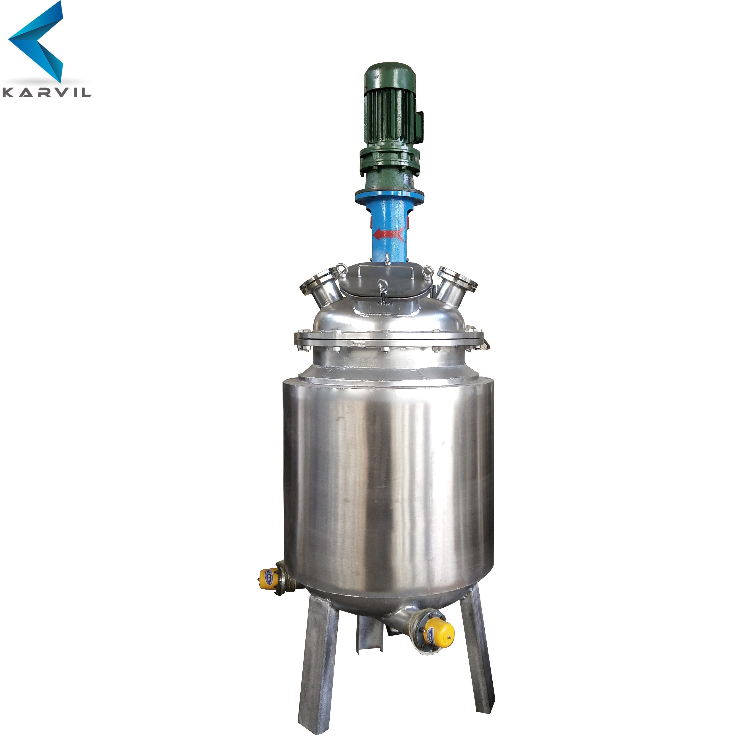
Future Research
AI-controlled synthesis is like a young teenager starting their first job: fully operational and somewhat competent but slow and naive ... not the most hirable candidate yet.
Areas for Improvement
User-friendliness
Speed
Customization
Cost
Synthesis Type
Feedback

Slide 10
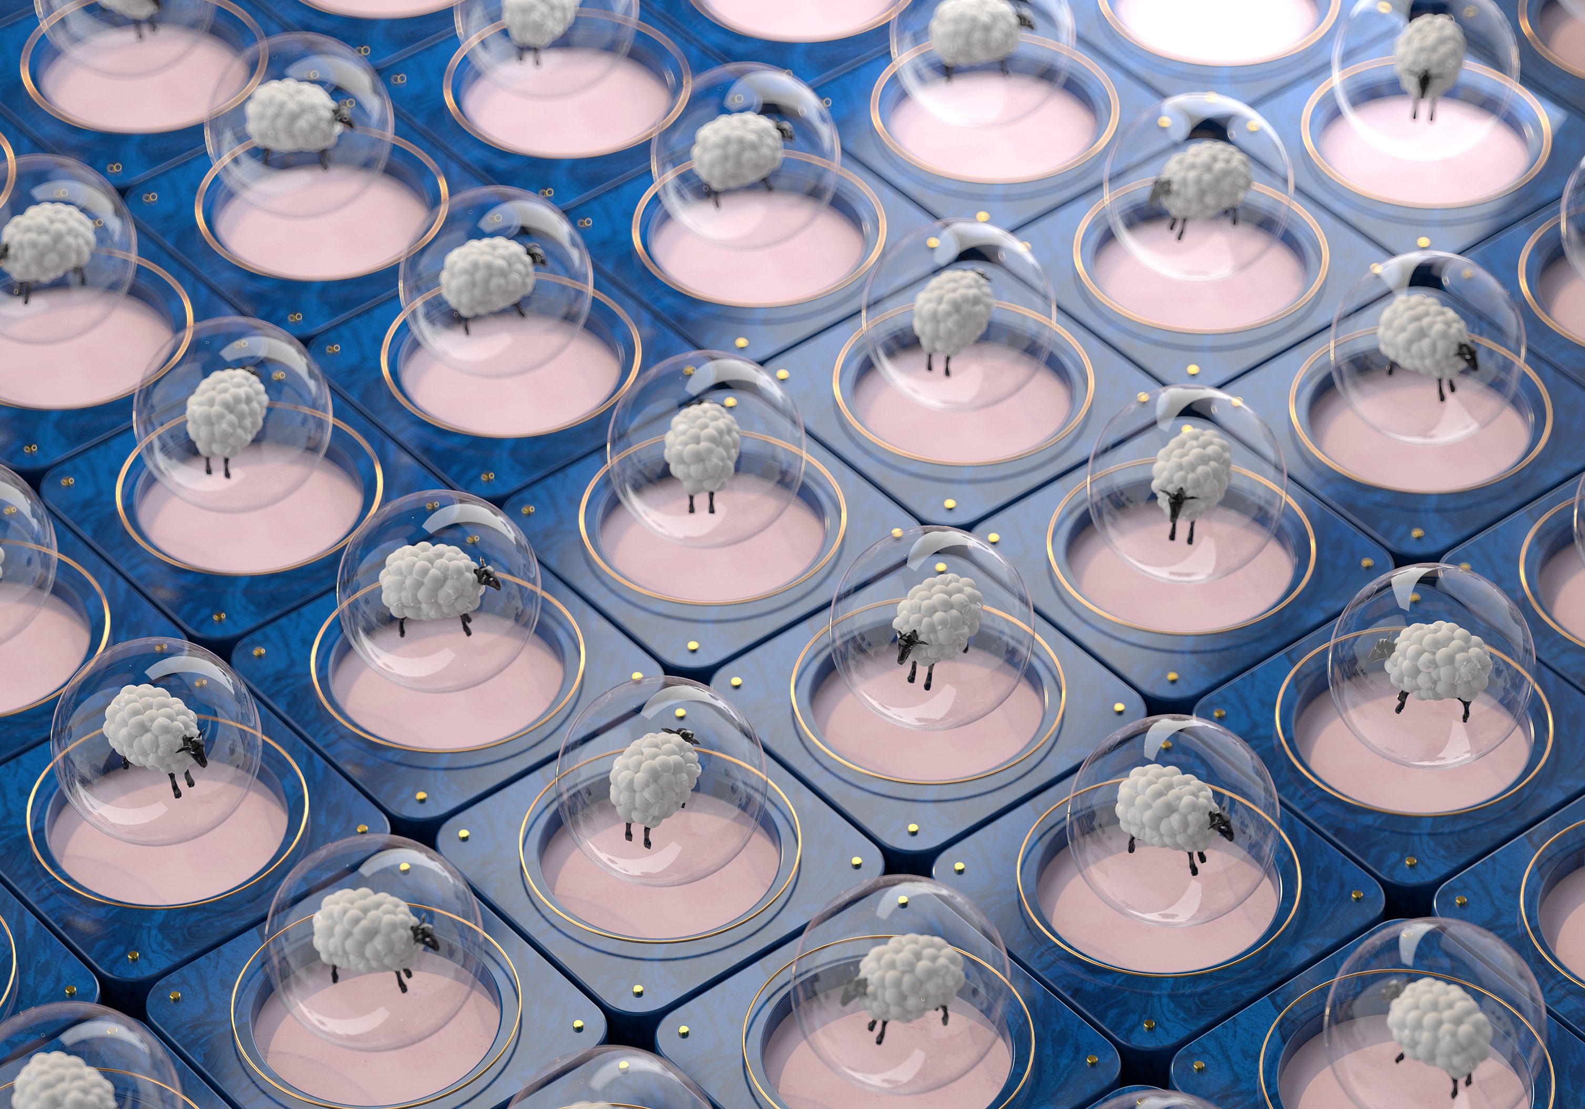
Analysis and Questions:
Computational Chemistry
Security
Efficiency
Database Limitations

Slide 11


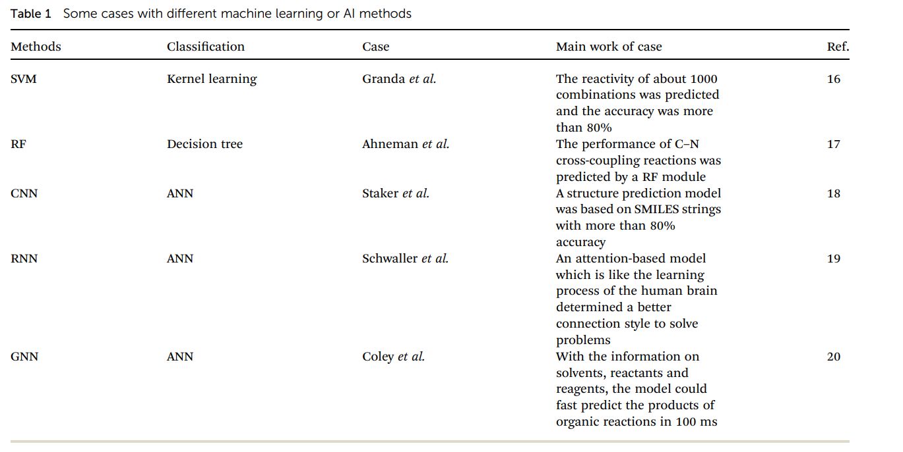
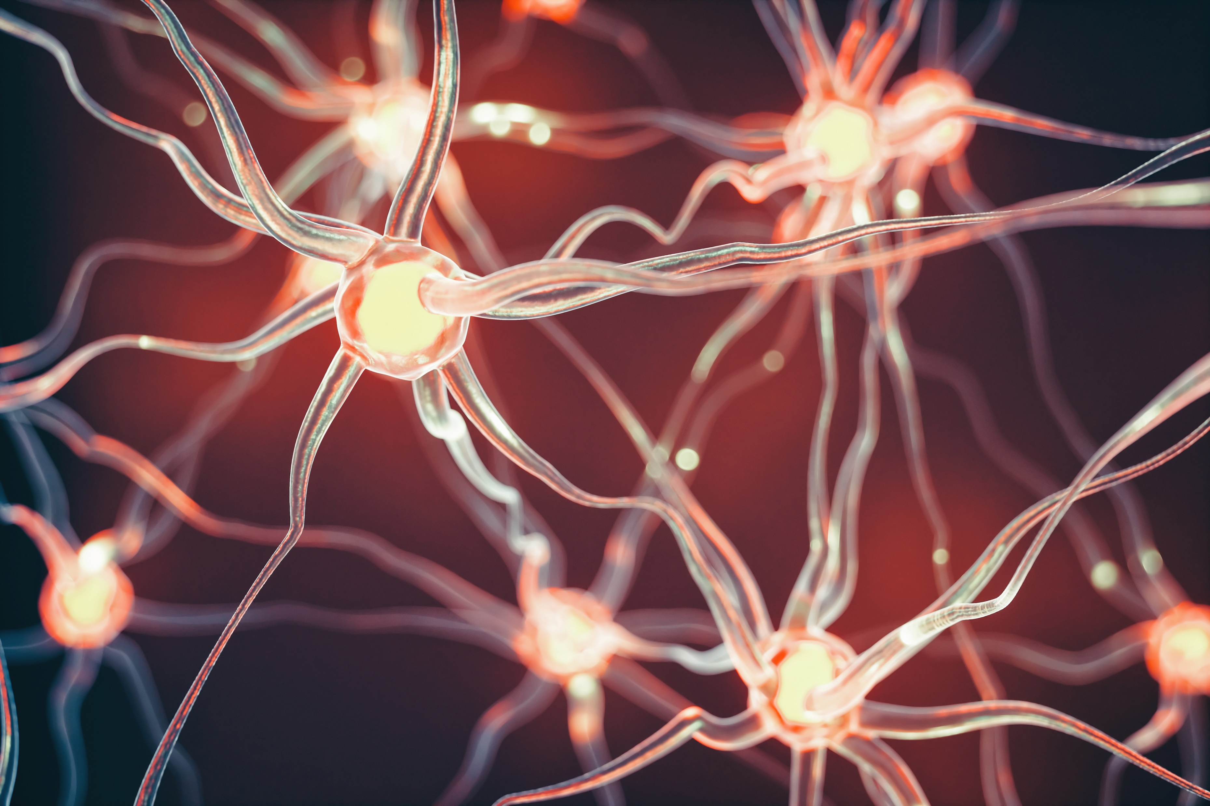

Conclusion and Appendix

